Slide 1
Payment Transactions
By: Team Vulcan
(Sahil, Mugdha, Madhav, Asma, Aayush)

Slide 2

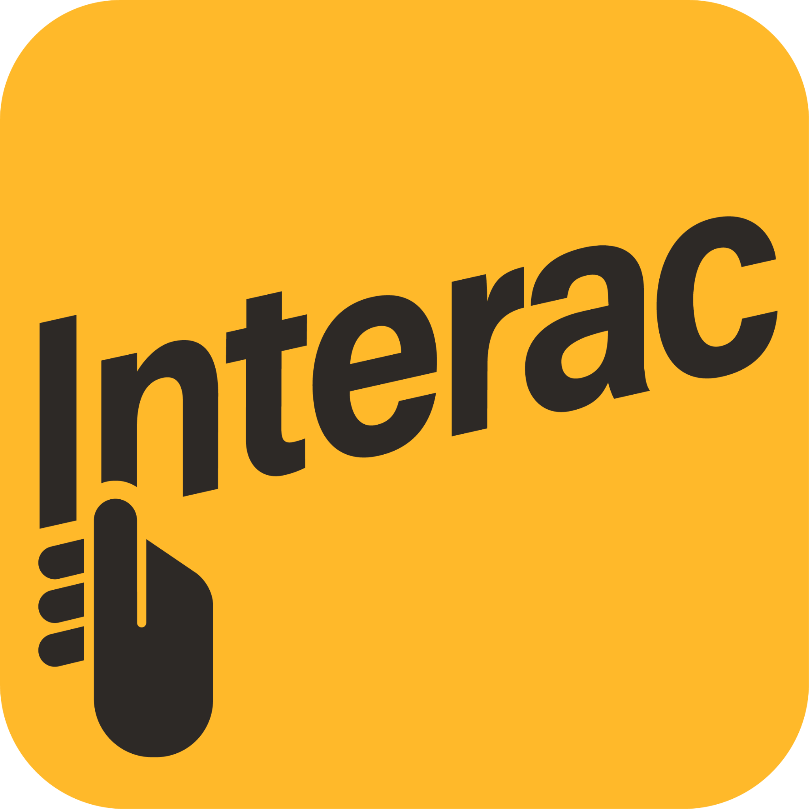

Problem Space
Millions of transactions are made today between
People to people
People to business
Business to business
Plenty of Transactions are still hard to make
Take very long
Require a lot of information
Prone to human error and fraud
Have amount limits and require fees
Huge race in making the payment experience better
Contactless payments
Interac E-transfers
“Wallet” apps such as Paypal

Slide 3
STAKEHOLDERS
Primary
Individuals involved in making a transaction (both the sender and receiver)
Could involve personal transactions (such as e-transfers) or business transactions
Secondary
Banks, 3rd party companies, Cryptocurrency fulfilment organizations
Tertiary
Fintech competitors, Central Bank, National and International Monetary Organizations, Government auditors

Slide 4
Background & Why?
Payment methods in the 80s required extensive knowledge about encryption and data transfer protocols, with a high barrier of entry.
Now, retailers provide broad range of payment methods, satisfying multiple demands like low-friction payments, cost-splitting, EMI payment plans, etc.
Why decrease friction, and improve convenience and security?
E-commerce retail sales in the Canada reached $52 billion in revenue in 2022, and is projected to double in 5 years, so creating a better solution provides immense value.
The ability to create the best experience in convenience, safety and variety in payment methods is the difference between keeping and losing considerable portions of the target consumer base, and is very important for customer acquisition and retention.

Slide 5
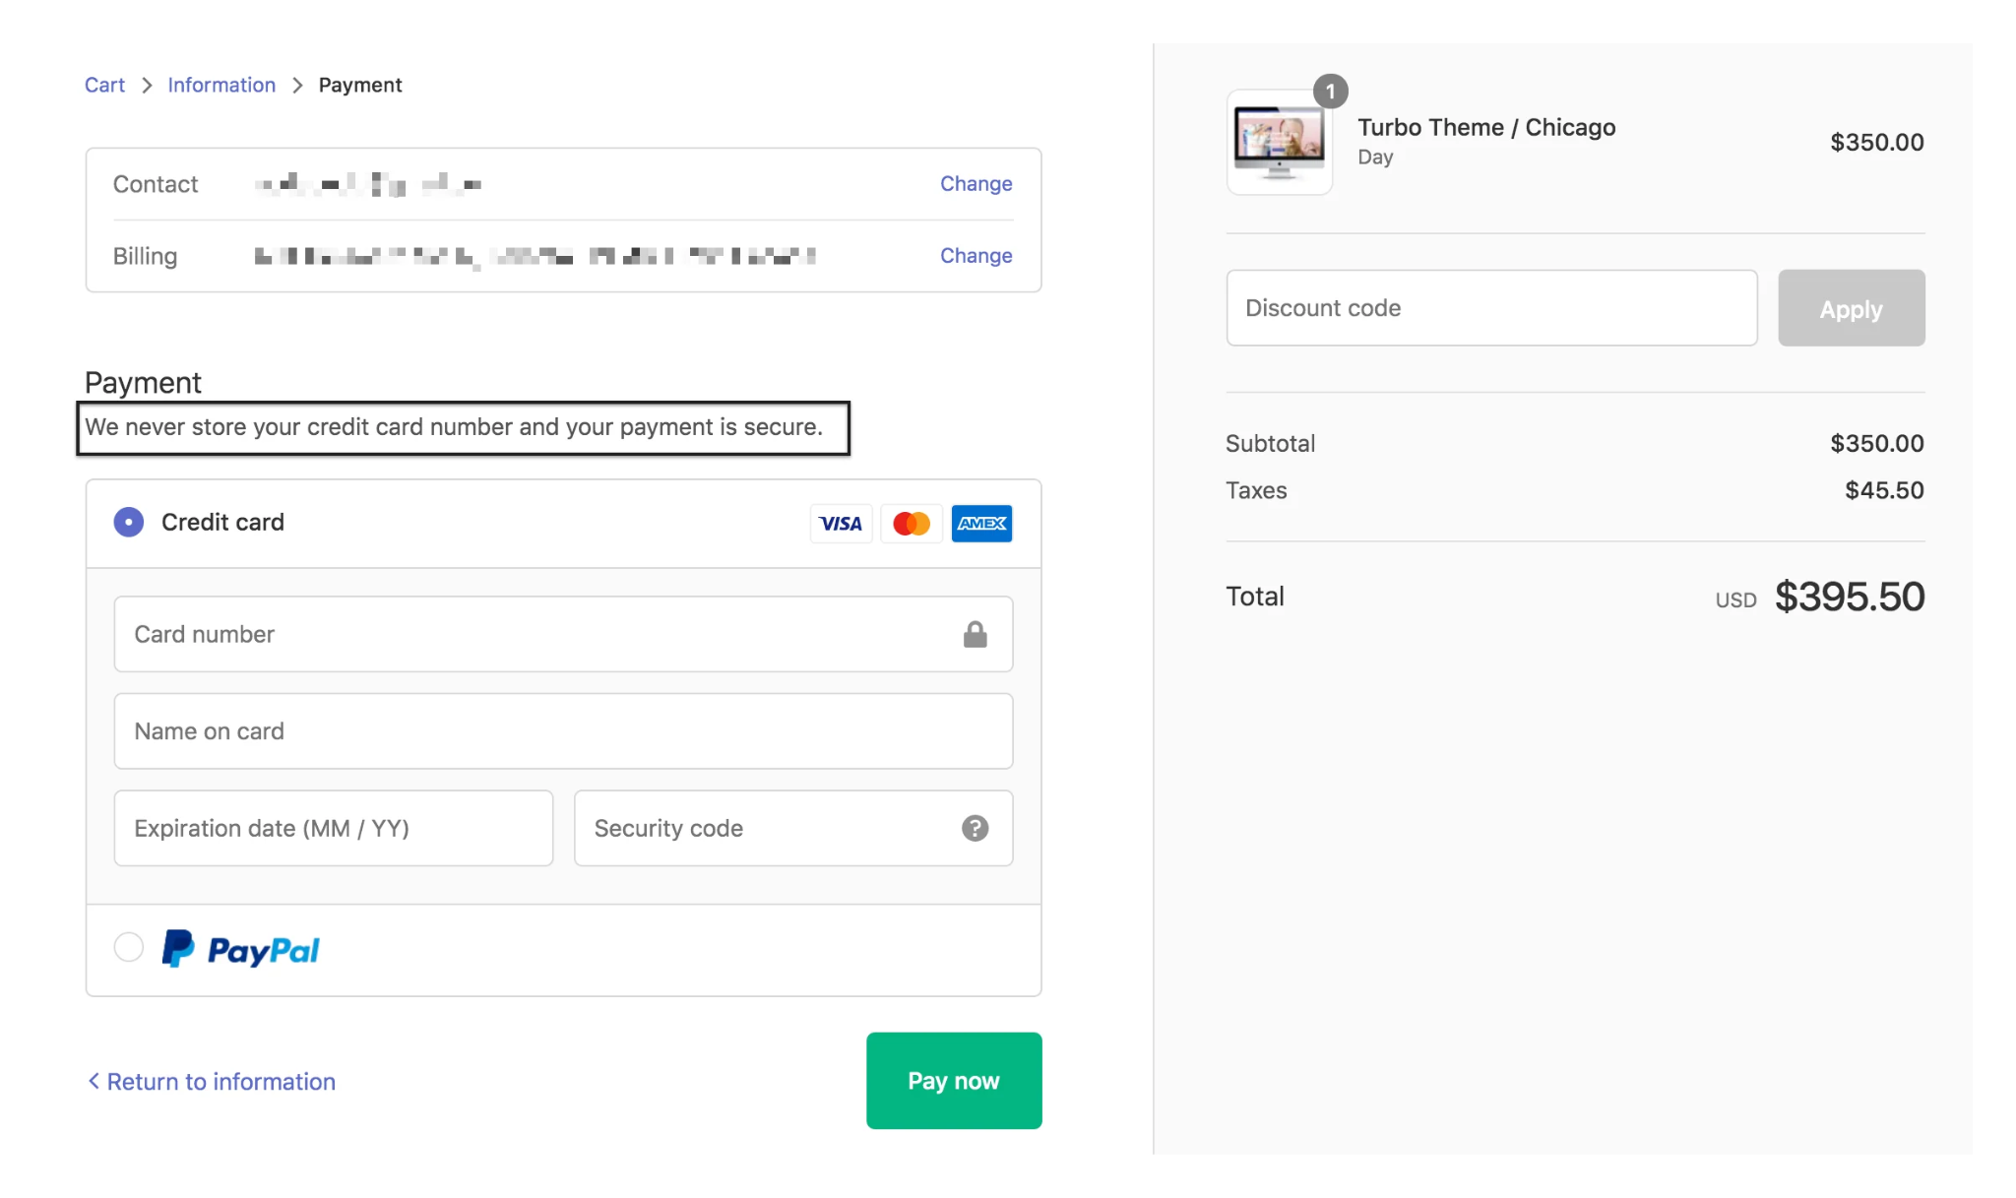
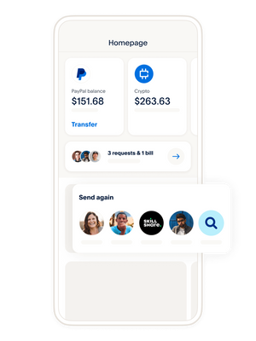
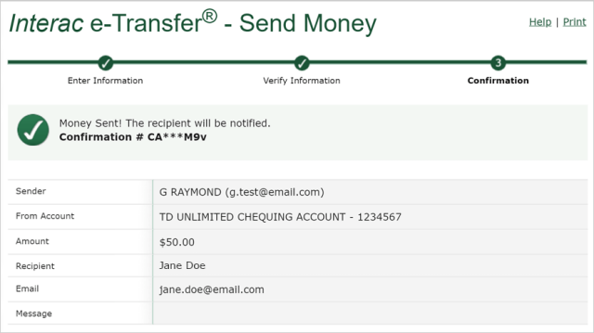
The Experience
Requires a lot of information
A lot of repeated steps
No option to automate payments
Manually typed information is prone to a lot of errors.
Deleting or Editing transactions is difficult

Slide 6
Our Focus
Find solutions to improve the usability and usefulness of a payment transaction for those making one.
Create features to help
Authenticate transactions faster
Grab sender and receiver details faster and efficiently
Ensure security throughout the process
Automate payments if needed
Remove fees and amount limit

Slide 7
Use-cases
Send money in group settings
E.g. paying someone back after a group dinner
Send money to stores and businesses
E.g. buying something from an independent seller
Send money to anyone
Send Crypto
Send money internationally
In general …
We use and send money everywhere!

Slide 8

Methods of Research
Questionnaires:
In order to reach out to a larger and diverse audience, we will be using Questionnaires to gather quantitative data about the difficulties people encounter when making electronic money transfers.
It removes the the time and regional constraints on the number of individuals we can connect with.
It might be an easier option for people with speaking and hearing disabilities.
We intend to create a trial questionnaire for a small set ( < 20) of people. After obtaining their consent for participation, we will ask them questions related to the problem space and feedback for the questionnaire. Based on their responses, we aim to improve upon our questionnaire.

Slide 9
Interviews:
Conducting in-depth interviews with a smaller group of participants allows deeper understanding of otherwise invisible, qualitative experiences (thoughts, ideas, biases and motivations) and challenges with electronic money transfers.
An understanding of their experience and usage allows us to design a solution that works for them as opposed to solving an issue based on quantitative data.
Interviews also allows us to construct questions without limitations as opposed to a questionnaire.
Semi-structured interviews can be particularly useful as they allow for flexibility in exploring individual perspectives and probing for details.

Slide 10
Physical Data:
We can analyze tickets complaints, and feedback related to electronic money transfers from various sources such as customer service records, online forums, and social media.
We can utilize case studies of individuals or businesses that have encountered difficulties during electronic money transfers.
Getting more information about the servers and automated transit machines to understand its technical difficulties it might be facing due to a bug or site traffic.
Observational Methods:
We can observe people’s attempt to make a bank transfer or use our on experiences on what issues we and they were facing during the transaction.
Getting to know the issues what people face during the process by monitoring the way they interact with the system with their emotional behaviour as well.

Slide 11
Our Next Steps
The world of transactions is very huge and impacts all categories of people. Hence, we would like to begin by focusing on the experiences of these two categories: ‘students’ and working adults’ as they are the easiest to access.
We will also be creating trial scripts for questionnaires and interviews and testing them on a small subset of the above population.
We aim to conduct in-person observations on the team members (while they are doing transactions) first and then move onto the stakeholders.
We expect our methods of research to help us narrow down our scope and identify the most recurring theme and problem when making transactions. Our group will then decide on a specific focus based on our analysis of the information.

Slide 12
Questions
For our interview script, we are asking people about the types of transactions they make. Specifically, we are asking people about transactions they make between people they are involved with (such as their friends) and why they would need to make such transactions in first place. When asking questions like these, do you think there’s any boundaries we need to consider?
We would like to conduct in-person observations for the theme to learn more about people’s experiences with transactions. However, due to concerns of privacy, it will be difficult to conduct them with a large number of and diverse people. We would like to know what can be done to address the element of privacy concern?

